Slide 1








INFORMATION SYSTEMS 1.2 PROJECT
AIITY1A
LIBRARY MANAGEMENT SYSTEM
NELLYLYN MOYO
GROUP 31
STUDENT NUMBER | SURNAME AND INITIALS | SIGNATURE
226059354 | LEBEKO SURPRISE SHAI
225213635 | AYANDA LETTIE MABASO
226000377 | BASETSANA KHENSANI MADIBA
225272619 | NALEDI MARIA MAHLATJI
226027946 | NJABULO HLELOLWENKOSI MTSHALI
226011282 | LINDOKUHLE SHAUN NGWENYAMA
225276701 | MAKHADZI BEYONCE LUDERE MULAUDZI
240182200 | MBANJWA LUVUNO

Slide 2
TABLE OF CONTENTS
INTRODUCTION
PURPOSE
WHY WE CHOSE THIS DATABASE
HOW THE LIBRARY WORKS WITHOUT A DATABASE
MAIN PROBLEMS WITH THE CURRENT DATABASE
WHY WE NEED A DATABASE
FIRST NORMAL FORM
SECOND NORMAL FORM
THIRD NORMAL FORM
ENTITY RELATIONSHIP DIAGRAM
CONCLUSION

Slide 3
LIBRARY MANAGEMENT SYSTEM
WHAT IS A LIBRARY MANAGEMENT SYSTEM?
A library management system is a system that automates everything a library does manually, It is a system that helps a librarian to add books, find books, give books to students and take them back, and charge fines all in one place.
PURPOSE
The main goal of our system is to replace manual way of managing a library with a digital system. We want to replace paper registers with a database to maintain organised records of books, members, and transaction histories. We want a system that is fast and easy to use.

Slide 4
3.Our system aims to achieve the following:
1.Manage Books – Add, Update , and track all the books in the library.
2.Manage Members – Register new members and keep their details.
3.Manage Borrowing and Returning-Record when a book is borrowed and when it is due.
4.Calculate fines for late returns automatically.
5.Make it easy to search for a book by title, author, or category.

Slide 5
What a library does / What services it provides
Our Library helps people find books and borrow them. Our database management uses a computer system to keep track of all the books, the people who borrow them and the staff that works there. Our database provides reservations, clients can reserve books. The system keeps track of the date they made the reservation and how many books they want. The system makes it very simple for reservations, we know exactly which client reserved a book and on which date. The system helps the staff to manage clients more efficiently when it comes to borrowing of books, due dates etc.
How members borrow and return books / How books are managed
Every book is assigned with a unique BookID and tracked by the title and ISBN. Sometimes a book has more than one author and an author writes more than one book. To handle this, we use a special table called BookAuthor connecting the BookID to the AuthorID so we always know who wrote what. It is also a smart way to link books and authors without making a mess of the data. When a client borrows we create a record in the reservation table. It saves the ClientID, LibraryID, date and quantity. When they return the book, we update it. So we always know who has which book.

Slide 6
WHY DID WE CHOOSE THIS MANAGENT SYSTEM
We chose a library management system because in almost every community and school they are still using paper to record details and information of books borrowed, which ultimately leads to books getting lost, records being duplicated, and a lot of time is wasted. It is a problem that can be applied in real life and solved with IT skills.
EXPLAIN WHY WE CREATED THE SYSTEM
As IT students this project allows us to practice database design , user interface and lastly system development. While creating a system that is useful to our community and our Institution Library.

Slide 7
EXISTING RECORDS KEEPING AND PROCESSES DESCRIBED
1.Member Registration
When a person signs in at the library, The staff collects primary details such as student or client ID and other secondary details such like contact details, first name and last name. Without a proper library system these details may be written on a spread sheet. Member information can may be lost or duplicated by using this type of registration.
2.Record Books
When new books are received at the library , the staff may have to manually record information such as category , edition, number and date, this can make it difficult to know exactly how many books are available and where they are.
3.Tracking Overdue Books
The staff will have to check loan records to determine which books have passed their return due times and dates , and this may become time consuming and overdue books may be overlooked.
4.Maintaining Records
The library may have information leak across files and physical records and this may cause a problem as information is not centralised which makes it harder to keep everything updated and in the right order.

Slide 8
MAIN PROBLEMS WITH THE CURRENT SYSTEM
1.Duplication
The member’s and books information may be recorded multiple times
2.Difficulty finding information
Staff has to fiddle through the physical records and hard copies looking for certain information about a book or member which takes a long time.
3.Human Errors
Information can be recorded incorrectly
4.Data Inconsistency
Information in different records may not correspond.
In contrary a centralised database would allow the library to store and retrieve this information more efficiently
and accurately and make searching for books or information more easier and less time consuming.

Slide 9
WHY DO WE NEED A DATABASE?
We build a library management system database to replace slow manual paperwork with an organized, automated system that securely tracks books, users, and borrowing activities. In a file based system, the same data might be stored in multiple files. If that information changes, updating it everywhere is prone to error, leading to conflict records. A Database Management System centralizes data to a single source of truth.

Slide 10
HOW THE DATABASE DO SPECIFIC TASKS
Tracking Book circulation (returns and Checkouts)
The library must know who has a book, when it is due, and if it was returned
A transaction or record table links the member's ID with a book Copy ID, recording the issue date and return date. When a book is scanned, the database updates the item's status instantly from "available" to "Checked out".
Searching and Discovering Books
Members and staff need to find it a specific title or author is in stock without walking the aisles.
The book table contains indexed attributes like title author, ISBN and category. Search queries run against these indexed fields to return matching results in mini-seconds.

Slide 11
Managing Fines and Overdue Penalties
The library needs to penalize late returns to encourage people to bring books back
The system compares the current date against the due date stored in the transaction record. If the due date has passed, the database calculates a time based on set rules and links that balance directly to the members account.
Controlling Access and user Roles
Only staff Should be able to add new books or delete records, while regular members should only search and view their Own data.
An admin or user table Stores hashed passwords and permission leves. When a user logs in, the system checks their assigned role before permitting specific actions.
Generating Reports and Insights
Librarians need to See which books are popular and how many items are circulating to guide future purchases.
The database runs aggregation queries across transaction history tables to summarize usage trends, popular genres, and overdue counts into clean reports.

Slide 12
Data organisation
Stores books, members, and records in structured tables instead physical logbook.
Data Integrity
Enforces rules so that book details, member IDs, and transaction dates stay accurate and error-free
Automation
Handles routine tasks like calculating times or logging returns automatically
Security
Uses login credentials and user roles to control who can edit or view sensitive records.

Slide 13
Client & Reservation
Each Client must have a unique ClientID
A Client can make many Reservations
Each Reservation must belong to one Client
Each Reservation must have a unique ReservationID
Each Reservation must record the Reservation Date and Quantity
Each Reservation must be associated with a Library through a LibraryID
The ClientID in the Reservation table must reference an existing Client
Book & Library
A Library can store many Books
Each Book must have a unique BookID
Each Book must belong to a Library
Each Book record must contain the book’s Title, ISBN, Publisher, Edition, No Of Pages, and Price
The LibraryID in the Book must reference an existing Library

Slide 14
Book & Library
A Library can store many Books
Each Book must have a unique BookID
Each Book must belong to a Library
Each Book record must contain the book’s Title, ISBN, Publisher, Edition, No Of Pages, and Price
The LibraryID in the Book must reference an existing Library
Book & Author
A Book can have one or more Authors
An Author can write one or more Books
The BookAuthor table must be recorded in the relationship between Books and Authors
Each record in the BookAuthor must reference an existing Book and an existing BookAuthor
A combination of BookID and AuthorID must be unique to prevent the same BookAuthor relationship from being recorded more than once

Slide 15
Library and Staff
A Library can employ many Staff Members
Each Staff Member must work at one Library
Each Staff Member record must contain their home and Email Address
The LibraryID in the Staff table must reference an existing Library and Book
A Library can store many Books
Library and Book
A Library can store many Books
Each Book must be assigned to a Library
A Book cannot be assigned to a Library that does not exist in the database
A Library has a Name, Address, and Phone Number which should be recorded in the Library table

Slide 16
FIRST NORMAL FORM
Client | BookID | Title | ReservationDate | Author | Library Name | Staff Member
Leo | 7269 | SQL | 0018 | V.Zulu | The Book Garden | Basetsana
Mpho | 5432 | Food For Life | 0019 | A.Lennox | VUT Library | Ayanda
Andile | 9171 | Sergio The Lover | 0020 | S.Mtshali | Sebokeng Library | Mulaudzi
Sanele | 7145 | Love Conquers All | 0020 | L.Harvard | Books For All | George
Anele | 4589 | IT Law | 0021 | B.Phikwayo | Just Books | Tshepo
The first table is in first normal form because it contains atomic values. Looking at the 1NF table all columns contain a single value keeping everything in a single table causing massive data redundancy and anomalies.

Slide 17
SECOND NORMAL FORM
Library Name | Location | Phone No | Staff Member
The Book Garden | Brakpan | 0114567891 | Basetsana
VUT Library | Vanderbijlpark | 0213452956 | Ayanda
Sebokeng Library | Sebokeng | 0112349876 | Mulaudzi
Books For All | Vereeniging | 0129823480 | George
Just Books | Krugersdorp | 0119126732 | Tshepo
The following tables are in second normal from. We say this because there is no partial dependencies meaning all non-keyed attributes must be fully dependent on the entire Primary Key for example (Title, ISBN, Edition, and Author) is entirely dependent on Book ID. Also (Location, Phone number and Staff Member) are dependent on the Library.

Slide 18
THIRD NORMAL FORM
CLIENT
ClientID | First Name | Last Name | Phone No | Address
7269 | Leo | Brown | 065 116 9781 | Vanderbijlpark
5432 | Mpho | Thabethe | 079 806 8981 | Evaton
9171 | Andile | Magwaza | 073 900 2280 | Vanderbijlpark
7145 | Sanele | Mthethwa | 078 935 1234 | Sebokeng
4589 | Anele | Mbanjwa | 069 123 0945 | Krugersdorp
BOOK
BookID | Title | ISBN | Publisher | Edition | No Of Pages | Price
2714 | SQL | 2449 | V.Zulu | 1st | 100 | 250
2651 | Food For Life | 1246 | A.Lennox | 2nd | 70 | 150
25789 | Sergio The Lover | 23698 | S.Mtshali | 2nd | 100 | 250
3672 | Love Conquers All | 7512 | L.Harvard | 3rd | 90 | 200
20132 | IT Law | 1290 | B.Phikwayo | 1st | 340 | 300

Slide 19
RESERVATION
ReservationID | Date | Quantity
0018 | 2026-10-12 | 1
0019 | 2026-10-19 | 1
0020 | 2026-10-20 | 1
0021 | 2026-10-25 | 1
0022 | 2026-10-25 | 1
AUTHOR
AuthorID | First Name | Last Name
2468 | Shaun | Ndlovu
2364 | Victoria | Zulu
1292 | Anne | Lennox
3519 | Quinton | Jones
1992 | John | Stones

Slide 20
LIBRARY
LibraryID | Names | Address | Phone No
2011 | The Book Garden | Brakpan | 011 456 7891
1924 | VUT Library | Vaal University | 021 345 2956
2423 | Sebokeng Library | Sebokeng | 011 234 9876
2112 | Books For All | Vereeniging | 012 982 3480
1905 | Just Books | Krugersdorp | 011 912 6732
STAFF
StaffID | Names | Email
5671 | Basetsana | basi@gmail.com
5811 | Ayanda | aya@gmail.com
2392 | Mulaudzi | mulaudzi@gmail.com
3894 | George | geo34@gmail.com
5858 | Tshepo | tshepo23@gmail.com
The following tables are now in third normal form. This is because there is no transitive dependencies, every attribute depends on only the primary key and not on other non-key attributes. The database is now highly optimised, flexible and free from insertion, update and more.

Slide 21
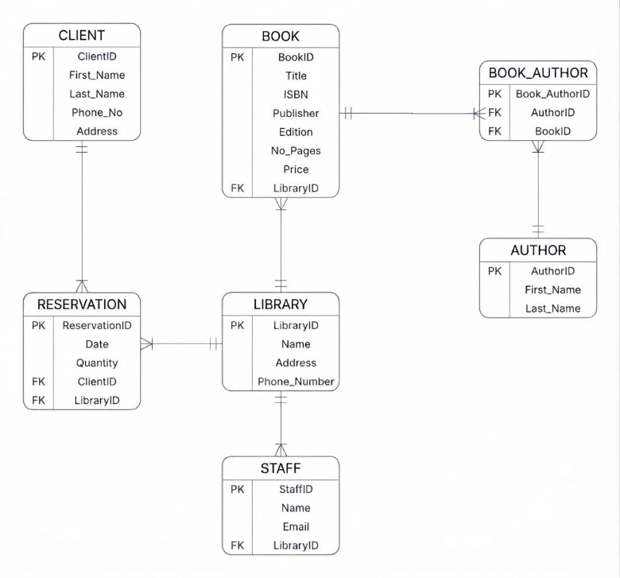
ENTITY RELATIONSHIP DIAGRAM

Slide 22
Conclusion
The investigation of the current manual Library system shows that operating without a centralised database creates significant operational inefficiencies. The main problems identified are data duplication, difficulty in finding information, human errors and lack of centralised database.
This is evident in how the library currently works. Member registration is done on paper forms or spreadsheets, which leads to lost or duplicated information. Recording books is manual making it difficult to know how many books are available and where they are. Tracking overdue books requires staff to manually check loan records, which is time consuming. And maintaining records is spread across files making it hard to keep information updated and consistent.
Plus the database solves specific task such as tracking circulation, searching books, managing fines, controlling access and generating reports.
In conclusion moving from manual system to database driven library management system will eliminate duplication and errors, centralise all information, improve efficiency and provide secure and fast access to data for both staff and members.

